Slide 1
Image Filtering
Standard Median Filter
The standard median filter is a noise reduction method that is very effective in preserving the details of an image.
It replaces each pixel’s value with the median value of its neighboring pixels.
It performs great when dealing with salt and pepper noise, but it struggles when dealing with Gaussian noise.
For this exercise you are tasked to perform standard median filtering on an image that has been corrupted by noise.

Slide 2
Image Filtering
Standard Median Filter
The algorithm takes as input a noise image and the size of the median filter window and applies standard median filtering to the image by changing the value of each pixel with the median value of its neighboring pixels. Then, it returns the filtered image. It uses 0-padding in order to avoid the creation of black borders in the image.
Finally, the noise image is displayed alongside the filtered one.

Slide 3


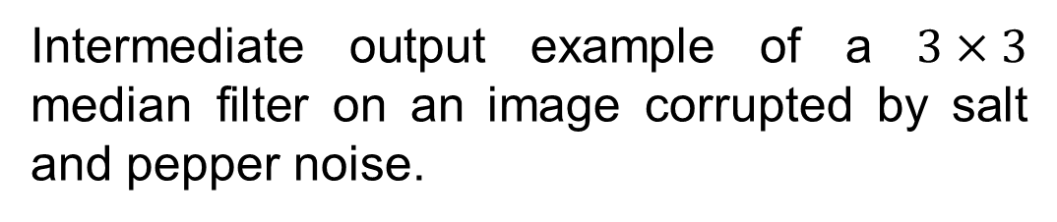
Image Filtering
Standard Median Filter
Input example.
Intermediate output example of a $3×3$ median filter on an image corrupted by salt and pepper noise.

Slide 4

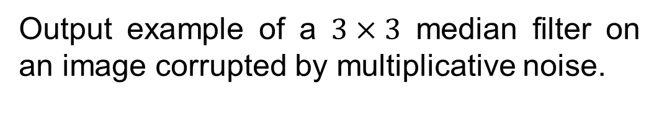
Image Filtering
Standard Median Filter
Output example of a $3×3$ median filter on an image corrupted by multiplicative noise.

